Slide 1
Development Tooling - Git

Slide 2
Introduction
This presentation will give you an introduction to the most commonly used version control system: Git.
We will be using Git throughout this course for project work.

Slide 3
What is a Version Control System?
A system that records changes to files over time so that you can recall specific versions later.
Benefits:
Traceability: Allows tracking of who made what changes and when.
Collaboration: Enables multiple people to work on the same project without stepping on each other's toes.
Backup & Restore: Can revert to a previous state if something goes wrong.
Branching & Merging: Work on new features or tests without affecting the main project.

Slide 4

What is Git?
A free, open source distributed version control system
Git is the most popular Version Control System (VCS) in the world
Facilitates collaboration during software development
It is not just for coding; It's used for documents, designs, and more
Git is a primarily a Command Line tool, with different GUI options available

Slide 5
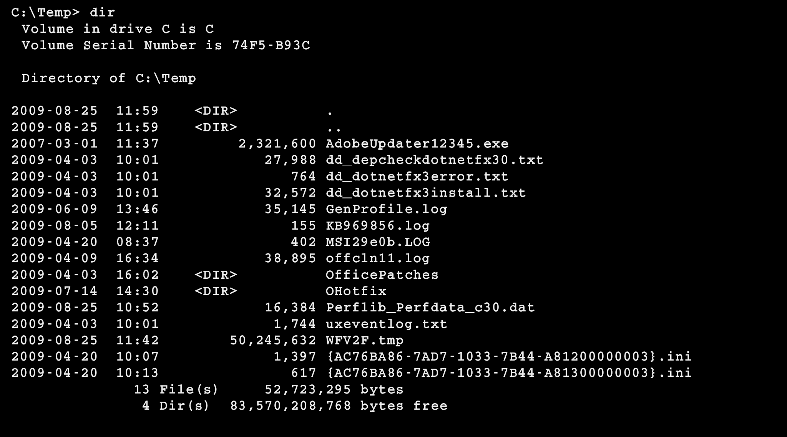
The Command Line
A command line is an interface to type text commands to perform tasks
Also known as: shell, terminal, or command prompt
Allows automation and control not possible with GUI
Powerful but less user-friendly than graphical interfaces
Common shells:
Bash (Linux, macOS)
PowerShell (Windows)
Zsh (macOS, Linux

Slide 6
Key Concepts in Git
Repository: project folder tracked by Git
Commit: snapshot of changes, bundled as single unit
Branch: distinct line of development within repo
Merge: combine changes from different branches
Pull request: propose changes from branch to main branch

Slide 7
Basic Commands
git init: initialize repo
git status: check state of working directory
git add: stage files for commit
git commit: save snapshot of changes
git push: upload commits to remote repo

Slide 8
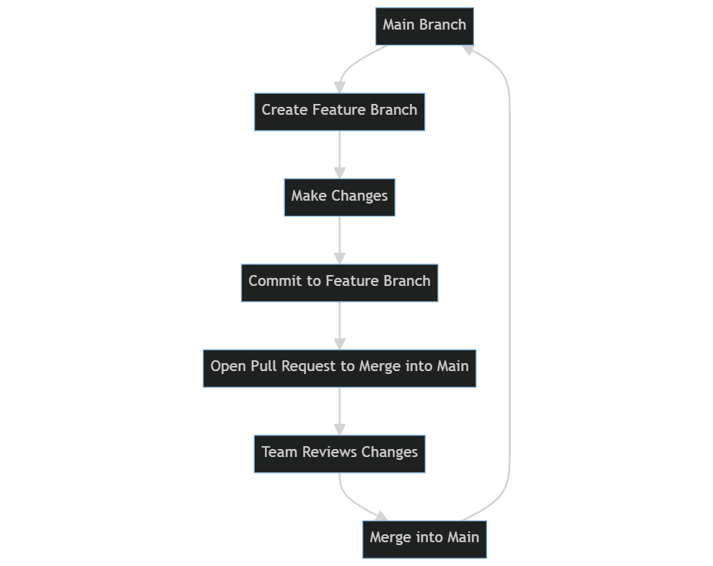
Branching Workflow
Create feature branch from main branch
Make changes, commit to new branch
Open pull request to merge into main
Team reviews changes before merging

Slide 9
Unique Benefits of Git
Open-source and free
Platform-agnostic
Distributed System
Speed
Branching & Merging
Staging Area
Strong Community & Ecosystem

Slide 10
Thank you!
Q & A

